Slide 1

Targeted Marketing Campaign for Internet Service Provider
Bhanu Suraj Malla

Slide 2
Business Problem
An internet service company based out of Phoenix is looking to expand its market share in the City. The company was providing services to 2 kinds of customers - individual customers and families; and small and medium size businesses. It was found out that the profit earned from small-size business such as restaurants, Fast Food chains was quite high; however, the company's market share of such customers was quite low (about 5%). From market research, the root cause for such a small market share was due to the customers not aware of the company and its services. Now, the internet service company aims to identify and target all the fast food and restaurant businesses using Foursquare API.

Slide 3
Background
The given internet service provider is the 5th largest cable service provider and amongst the top 20 internet service providers. In fiscal year 2017, it reported 0.7% customer growth, and this was largely attributed to reduction in broadband promotions. The company slowly started regionally customizable marketing campaigns while moving away from ‘one size fits all’ marketing philosophy. At the end of 2017, residential high-speed internet (HSI) broadband users grew at 24.7% while video customers decreased by 11.9%. One year later, over 60% of the company’s revenue was from residential broadband and business services. By 2019, a whopping 70% of the company’s subscribers preferred the buy only it’s broadband services rather than bundling it with video. With a slew of new marketing strategies in place and launched new product plans, the company looks to further reduce its customer churn through a data-driven model; and target small-sized businesses which show higher retention and lower customer churn.

Slide 4
Data
1. Phoenix zip codes were simply taken out from google search as in below link:
https://www.google.com/searchq=phoenix+zip+codes&rlz=1C1CHZL_enIN746IN746&oq=phoenix+zip+codes&aqs=chrome..69i57j0l7.3844j1j4&sourceid=chrome&ie=UTF-8
2. The zip code data exported from the above link is also uploaded in the link below:
https://github.com/mbsuraj/Clustering_Neighborhoods_Using_FoursquareAPI/blob/master/Phoenix_Zip.csv
3. The code to cluster the city and determine the zip codes for marketing campaign is in the link below:
https://github.com/mbsuraj/Clustering_Neighborhoods_Using_FoursquareAPI/blob/master/Neighborhood_of_Phoenix.ipynb

Slide 5
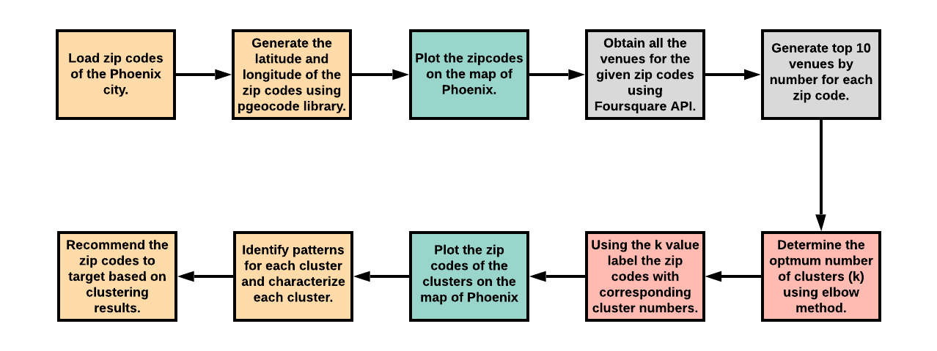
Methodology

Slide 6
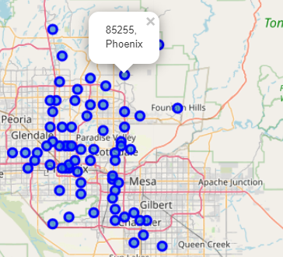
The Zip Codes Before Clustering

Slide 7
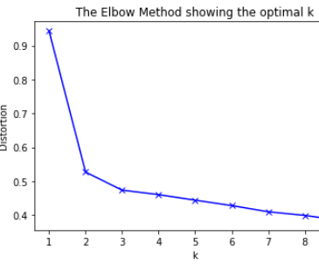
Elbow Method before Clustering

Slide 8
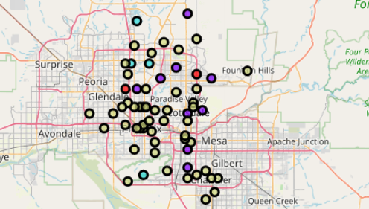
The Zip Codes After Clustering

Slide 9
Results
Cluster 0: Places to go for peaceful activities like Yoga, Rest areas etc.
Cluster 1: Places for any outdoor activity like soccer field, park, fishing spot etc.
Cluster 2: Fast food and restaurants
Cluster 3: Wide array of utilities and healthcare venues are present here.

Slide 10
Discussion and Conclusion
As noted above, all the zip codes in cluster 2 seem to be of fast food and restaurant type businesses. The internet provider now has the zip codes it can target for its initial marketing campaign and be assured of greater market penetration. However, I also believe the marketing campaign would not be as much straightforward. We would be learning several things during the campaign itself – such as customer feedback, customer sentiment and the company’s brand perception.

Slide 11

Thank You

